Slide 1
Unraveling Viral News: Decoding the Dynamics of Social Media Engagement and Article Popularity
Presented by: Lasya Priya Konduru
Instructed by: Prof. Ravindranath Arunasalam

Slide 2
contents
Abstract
Research question 1
Research question 2
Research question 3
Future Studies and Recommendations

Slide 3
Abstract
Social media has transformed the way news spreads, influencing public opinion and reshaping marketing strategies. As an analyst and an active social media user, I’ve often been intrigued by the randomness of virality and often think:
How does one article capture attention?
What makes them go viral?
What sentiment is most expressed through likes, shares, and comments? And so on,
I have formatted them as part of my research questions and analyzed them in the following slides.

Slide 4
Which news article characteristics make them viral across different social media?
Research question 1
Notes:
Aim: To identify key factors such as topics, headlines, and emotional appeal that drive news articles to achieve higher engagement on social media.

Slide 5
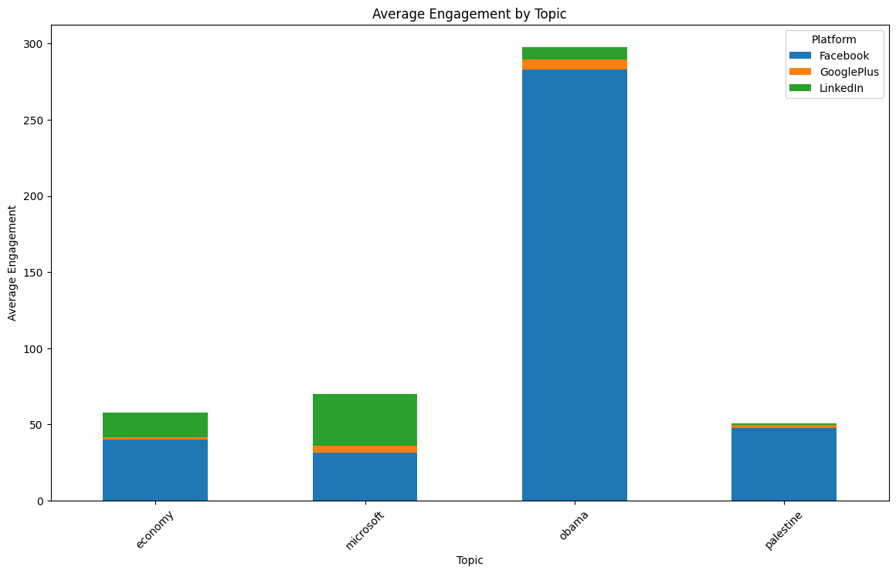
Topics that matter to people
Notes:
Topics like Obama and Microsoft are having more engagement.
These topics are already popular, and people are naturally interested in them.
People talk about High-profile political events or new tech product launches.

Slide 6
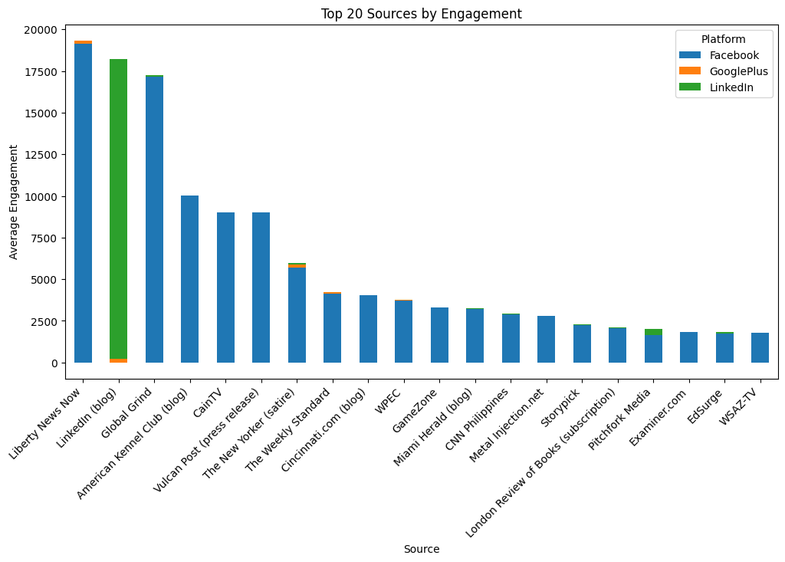
Sources of the News
Notes:
Consistent and loyal audience base contributes to virality.
Regular updates and timely publication around trending topics or global events enhance engagement potential.
Content aligned to user preferences tend to attract repeat engagement.
Certain sources tailor their content to suit platform-specific user behavior.

Slide 7
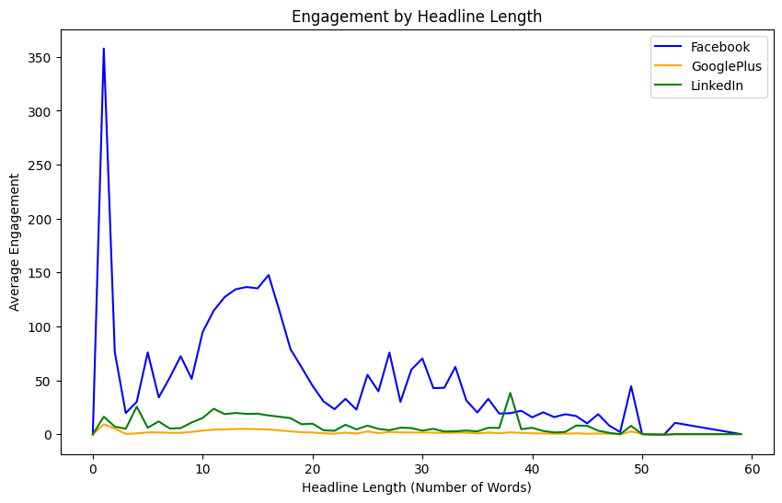
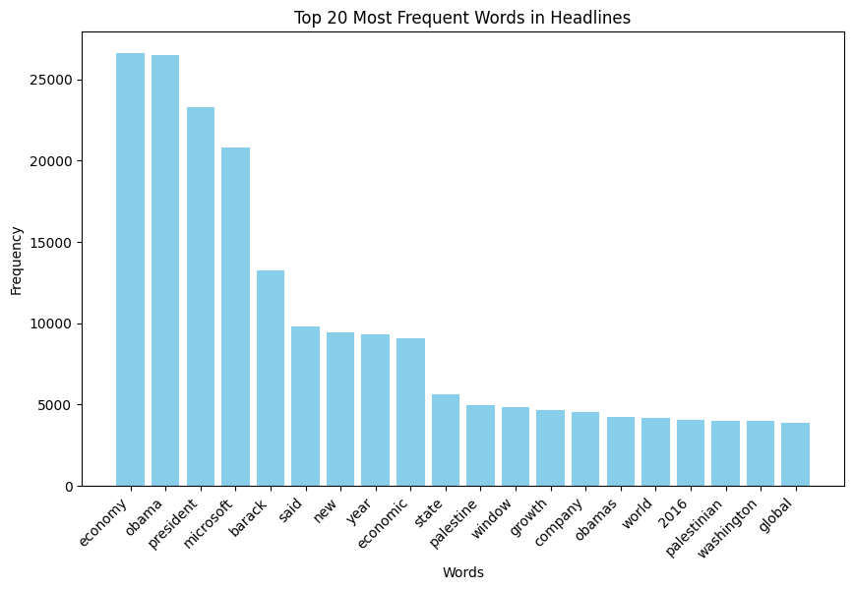
Strong and short headlines
Short and Strong Headlines goes viral
Notes:
1. Short, punchy and witty headlines are more likely to catch attention.
2. Headlines that use strong emotional words like "Obama," "president," and "Microsoft" appear often and attract more attention.

Slide 8
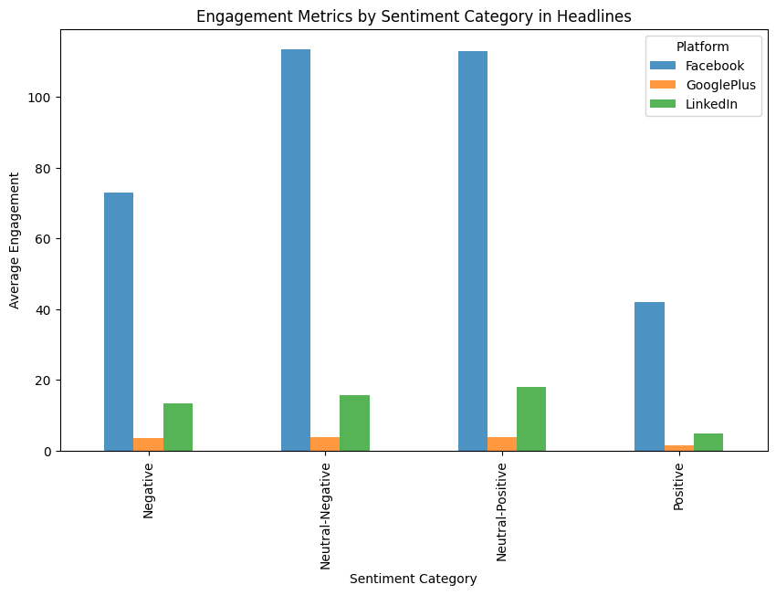
How people feel about the article
Notes:
The emotion behind an article plays a big role in how viral it becomes.
Negative sentiment (like frustration or anger) drives engagement on Facebook, and get lots of likes, shares, and comments.
Positive articles perform better on LinkedIn, where people look for advancing career or share professional content.

Slide 9
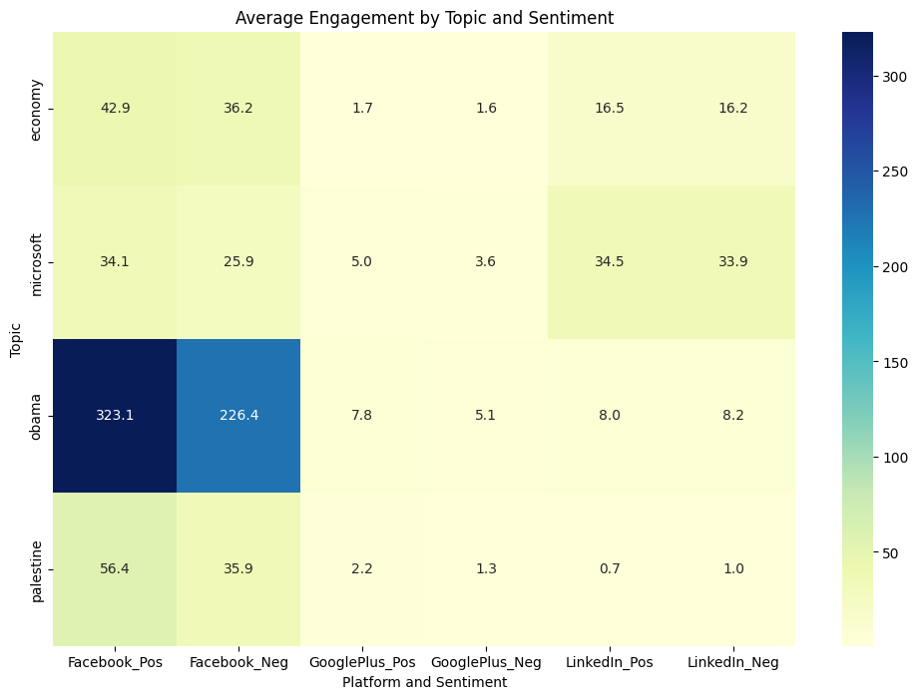
Platform-specific behavior
A major Political event was held in that year, 2016, hence “Obama” topic has gone viral.
Notes:
Facebook dominates in engagement compared to Google Plus or LinkedIn.
On Facebook, emotional and controversial content tends to do well. Political topics dominate because they often bring strong emotions like anger or excitement.
LinkedIn is more about professional and serious news, where users prefer neutral and positive content.
Engagement in GooglePlus was generally low, but it showed some preference for tech-related news.

Slide 10
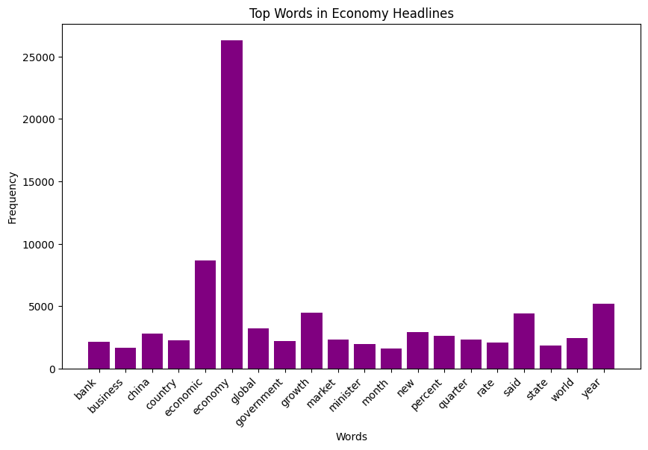
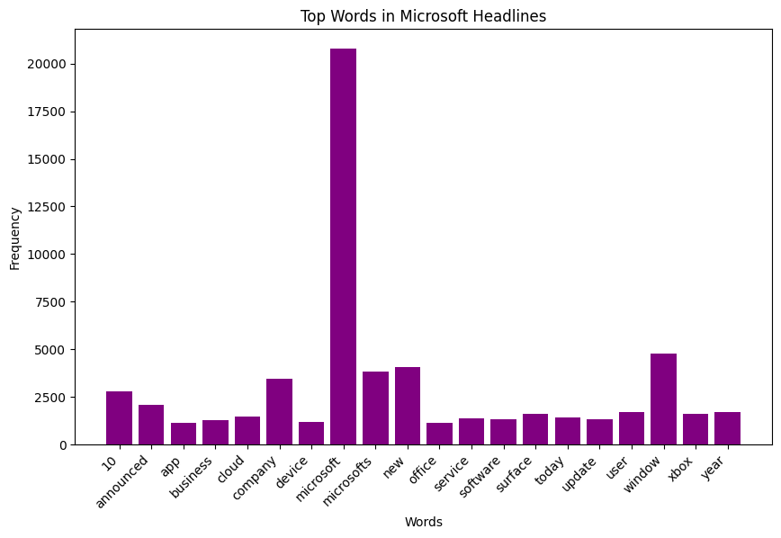
Articles that fit clear themes
Notes:
People like content that fits into well-defined categories they care about.
How often specific words appear in those clusters, drawing in audiences interested in those topics.

Slide 11
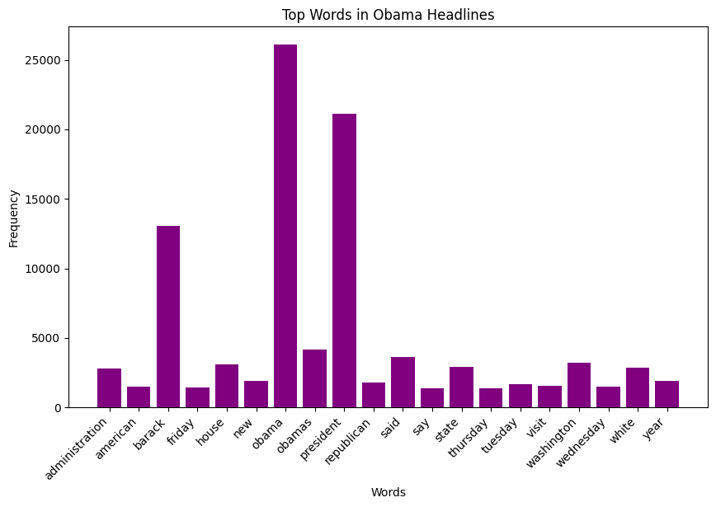
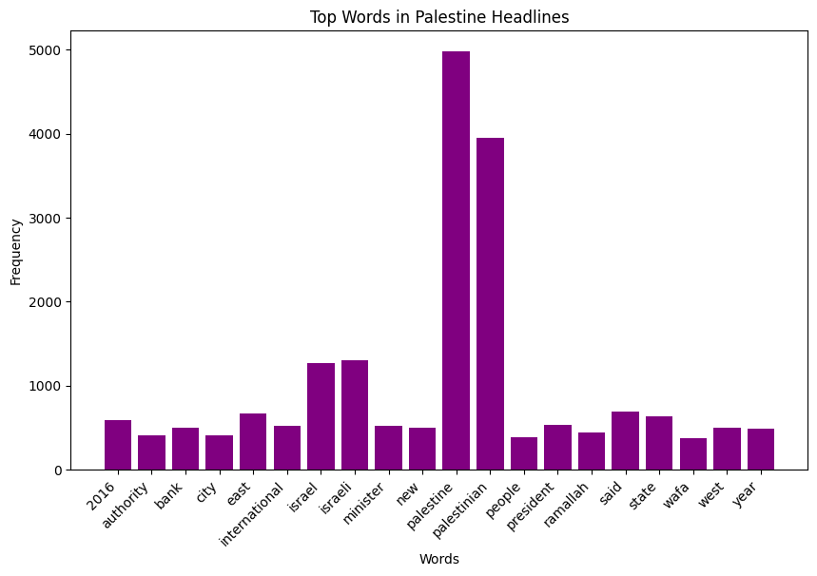
Articles that fit clear themes
Notes:
People like content that fits into well-defined categories they care about.
How often specific words appear in those clusters, drawing in audiences interested in those topics.

Slide 12
Summary of research question 1
NEWS ARTICLES GO VIRAL IF:
Focuses on major/global events like politics, product launches, etc.
They have short, emotional headlines that grab attention quickly.
Bring on strong emotions.
Which news article characteristics make them viral across different social media?

Slide 13
Is there any topic that makes some news more viral than others across different social media and changes over time?
Research question 2
Notes:
Aim: To explore which specific topics resonate most with audiences across platforms and how their relevance shifts over time.

Slide 14
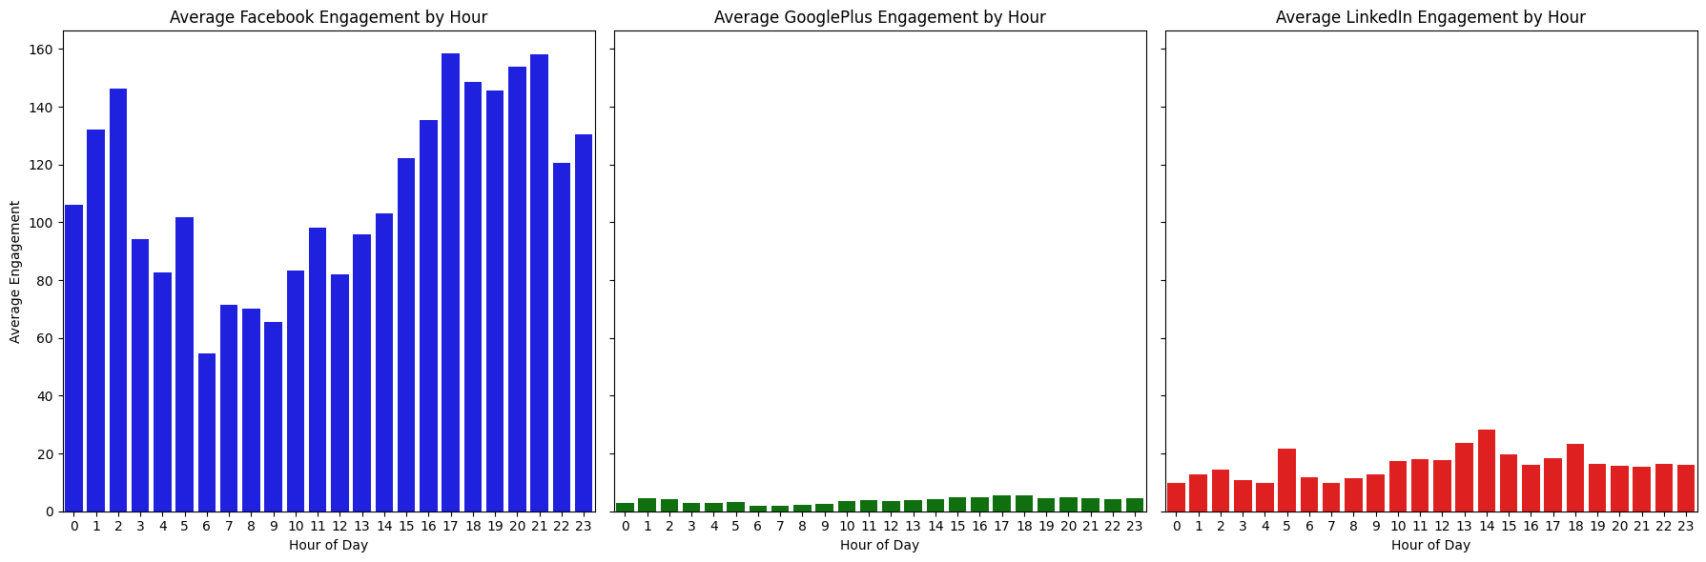
Platform-specific hourly patterns
People might have got off from work and relaxing
Probably lunch/leisure time to discuss/reflect on professional matters
Night Owls like me surfing social media all night
Notes:
Facebook: Engagement is consistently higher throughout the day, with peaks in the late evening and early morning (around 1 AM to 3 AM and again around 8 PM to 11 PM). This suggests that Facebook users are most active during leisure hours.
GooglePlus: Engagement is minimal across all hours, indicating the platform's relatively low user base or limited relevance for news sharing.
LinkedIn: Engagement peaks around mid-afternoon (2 PM to 3 PM), aligning with professional users' work breaks or activity spikes during business hours.

Slide 15
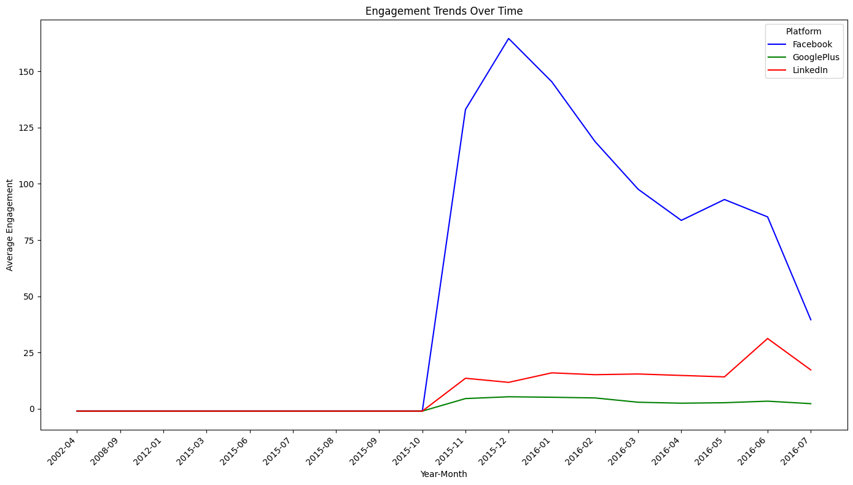
Engagement changes over time
Notes:
News virality can be seen in certain topics dominating during specific periods.
Political news about Obama surged during election years or major speeches.
Technology news like Microsoft’s product launches gains attention during key announcements.

Slide 16
Summary of research question 2
YES, POPULARITY OF CERTAIN TOPICS CHANGES OVER TIMES:
Politics dominates on Facebook during elections, speeches, or other major events.
Technology consistently performs well on LinkedIn and gains more attention during product launches.
Topics shift as global events change, which shows a dynamic pattern of virality over time.
Is there any topic that makes some news more viral than others across different social media and changes over time?

Slide 17
How does user sentiment in using likes, shares, and comments predict the popularity of news articles?
Research question 3
Notes:
Aim: To analyze how emotional responses reflected in user interactions influence an article's overall reach and virality.

Slide 18
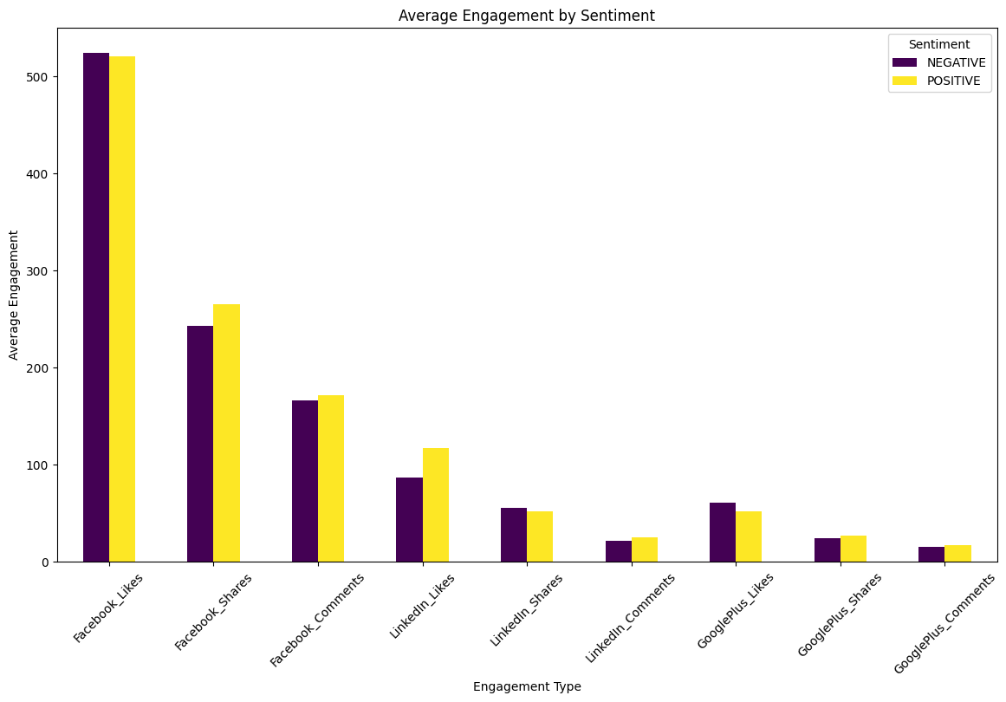
Likes, shares, comments respond to sentiment
Notes:
Likes: Negative sentiment drives more likes on Facebook, while LinkedIn favors positive stories.
Shares: Positive sentiment is more likely to be shared, especially on Facebook, where users want to share positive content.
Comments: Articles with strong negative or controversial tones see higher comments on Facebook, where users are more vocal about disagreements or strong opinions. But LinkedIn comments are again more positive

Slide 19
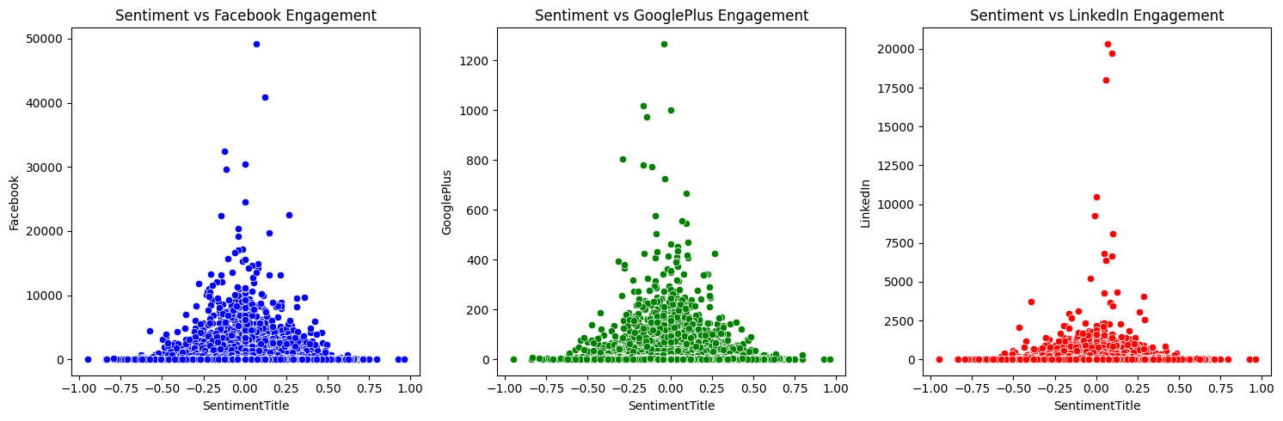
Strong correlation between Sentiment and virality
Notes:
Facebook: Sentiment around neutral to slightly positive has the highest engagement, with some spikes even with negative sentiment, this indicates emotional content often performs better.
GooglePlus: users show limited interaction with content regardless of its sentiment.
LinkedIn: Most high engagement occurs near neutral sentiment, with some activity extending into positive sentiment. LinkedIn users prefer professional or neutral-toned articles rather than emotionally charged ones.

Slide 20
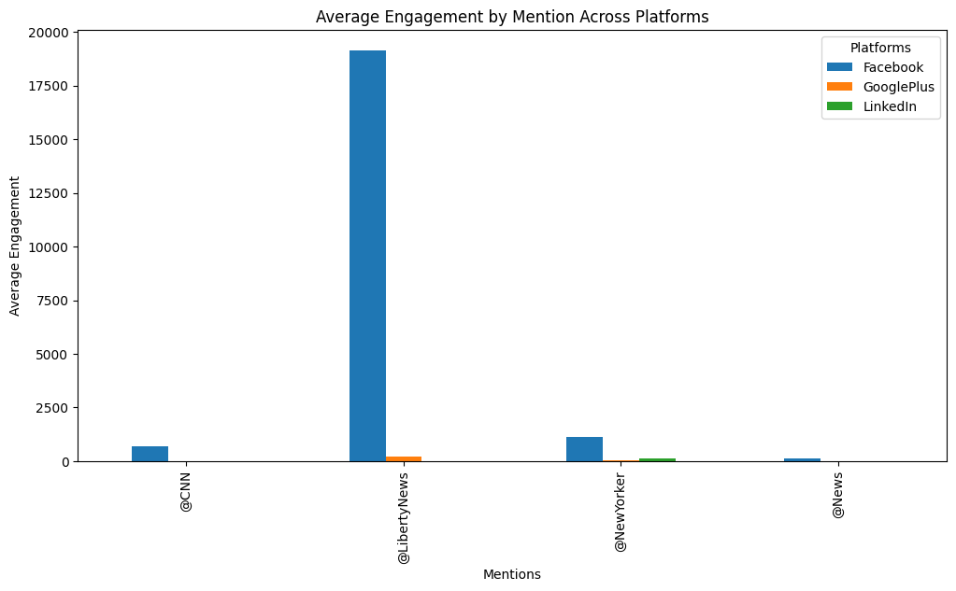
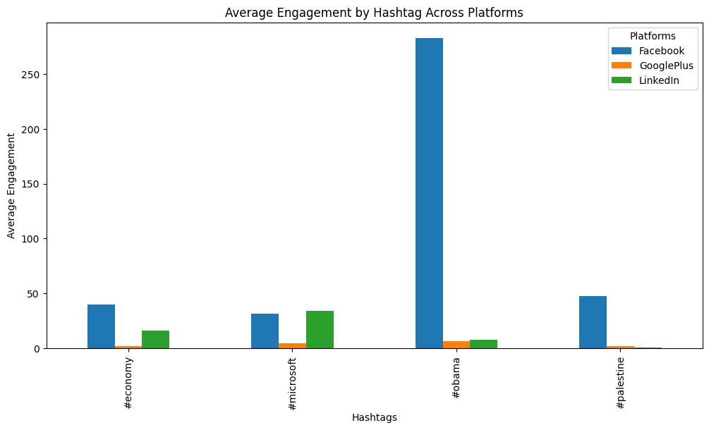
Hashtags and mentions are key
Notes:
Certain sources or entities associated with mentions may predict article popularity.
Hashtags related to trending or widely discussed topics outperform others, aligning with the preference for emotionally engaging or politically significant content.
Using emotionally charged hashtags or mentions often aligns with user sentiment (positive or negative).

Slide 21
Summary of research question 3
USER SENTIMENT – POSITIVE, NEGATIVE, OR NEUTRAL – STRONGLY PREDICTS HOW PEOPLE ENGAGE WITH ARTICLES BECAUSE:
Negative Sentiment works well on Facebook – likes, shares, and comments might be overflowing.
Positive Sentiment works better on LinkedIn since users prefer professional and constructive content.
Extreme emotions are more likely to make an article go viral than neutral ones.
Sentiment interacts with platform preferences and article topics to influence engagement.
How does user sentiment in using likes, shares, and comments predict the popularity of news articles?

Slide 22
Impact – what does the research influence?
CONTENT CREATERS
Help content creators and analysts understand what makes news go viral across platforms.
Support journalists in crafting engaging headlines and articles tailored to the audience.
Guides social media platforms in improving algorithms to promote meaningful and resonant content.
Help marketers in improving campaigns by aligning with audience sentiments and engagement trends.
JOURNALISTS
SOCIAL MEDIA PLATFORMS
MARKETERS
Notes:
Studies such as Kilgo & Sinta (2016) and Sangiorgio et al. (2024) underline how headline style and emotional resonance shape engagement.

Slide 23
Future work – potential against limitations
Limitations
Platform-specific engagement trends may not generalize across all social media platforms.
The dataset focuses on Facebook, LinkedIn, and GooglePlus, limiting broader applicability.
The dataset reflects engagement patterns only when collected and doesn’t account for evolving trends or changes in user behavior over time.
Future Direction
Include Instagram, TikTok, and others for a comprehensive analysis.
Explore video-based content dynamics in virality.
Investigate the role of time zones and global events on changing engagement patterns.
Develop machine learning models based on combined user interactions and sentiments to predict virality.
Notes:
References like Friedman (2001) on model development and Chuai & Zhao (2022) on the emotional drivers of virality support this vision.

Slide 24
References
Torgo, L., & Moniz, N. (2018). News Popularity in Multiple Social Media Platforms [Dataset]. UCI Machine Learning Repository. https://doi.org/10.24432/C5H029
Chuai, Y., & Zhao, J. (2022). Anger can make fake news viral online. Frontiers in Physics, 10. https://doi.org/10.3389/fphy.2022.970174
Friedman, J. H. (2001). Greedy function approximation: A gradient boosting machine. Annals of Statistics, 29(5), 1189–1232.
Kilgo, D. K., & Sinta, V. (2016). Six things you didn’t know about headline writing: Sensationalistic form in viral news content from traditional and digitally native news organizations. #ISOJ, 6, 111–130. https://www.researchgate.net/publication/303765927
Sangiorgio, E., Cinelli, M., Cerqueti, R., & Quattrociocchi, W. (2024). Followers do not dictate the virality of news outlets on social media. PNAS Nexus, 3(7), pgae257. https://doi.org/10.1093/pnasnexus/pgae257

